Slide 1
Australian Fatal Road Accidents

Slide 2
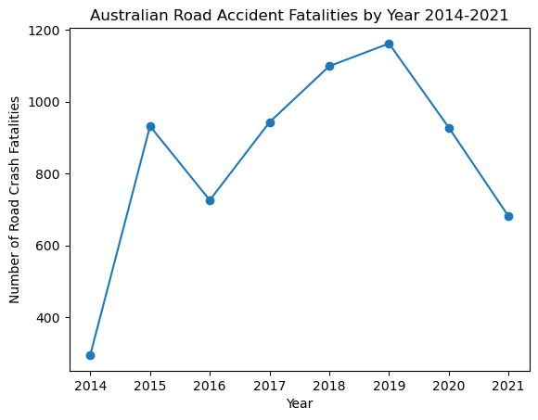
Figure 1: Line graph representing the number of fatalities from Australian road accidents per year 2014-2021.

Slide 3
Pitch target : Australian government advertising sector, to help them produce the most effective ad campaign to reduce road fatalities in Australia using Australian Fatal Road Accident data from 2014-2021 and answering 3 questions:
1. What is the profile of the person most likely to be killed in an Australian Road accident?
(Target Audience)
2.Where do most fatal road accidents occur?
(Where should the ads be played)
3.What conditions are a fatal road accident most likely to occur in?
(Factors to include in the ad)

Slide 4
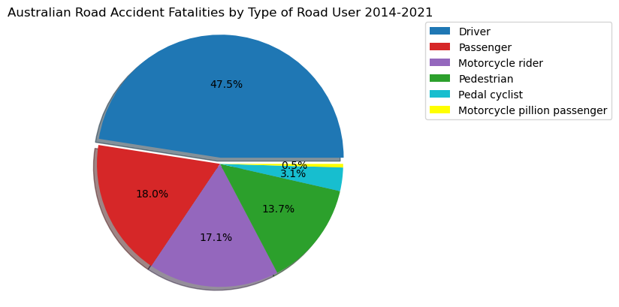
Figure 2: Pie chart representing the percentage of total fatalities in Australian Road Crashes 2014-2021 each road user group represents.

Slide 5
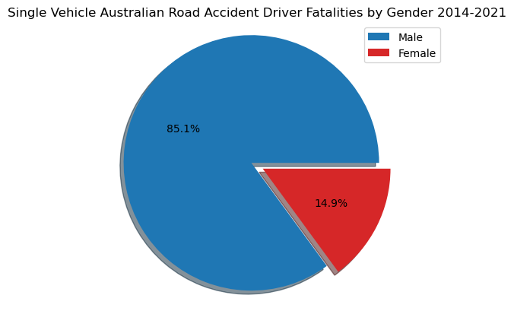
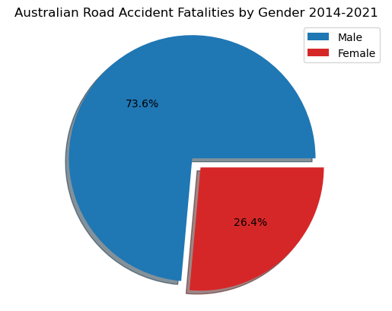
Figure 3: Pie chart representing the percentage each gender represents of total fatalities in Australian Road Accidents 2014-2021.
Figure 4: Pie chart representing the percentage each gender represents for single vehicle road accident driver fatalities in Australia 2014-2021.

Slide 6
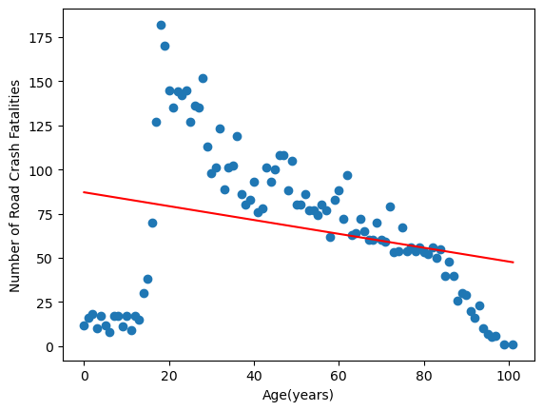
The mean age of the victims in Road fatalities was 67.66.
The median age was 66.
The correlation co-efficient between the age of the victim and the number of fatalities from single vehicle road accidents was -0.27.
Figure 5: Scatter plot representing the number of fatalities from Road Accidents in Australia 2014-2021 vs the age of the victim.

Slide 7
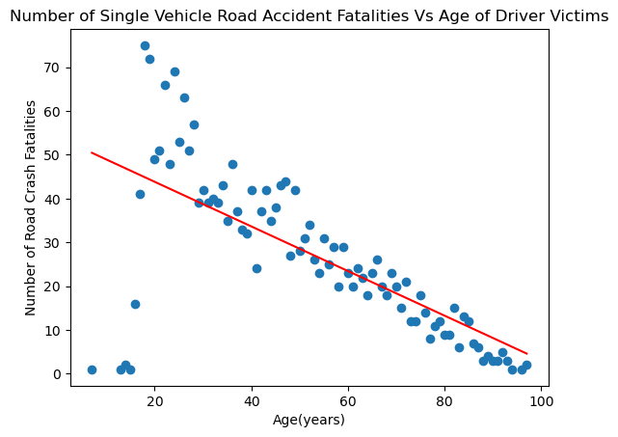
The mean age for driver fatalities in single vehicle accidents was 26.52.
The median age was 24.
The correlation co-efficient between the age of the victim and the number of fatalities from single vehicle road accidents was -0.68.
Figure 6: Scatter plot representing the number of fatalities from single vehicle accidents in Australia 2014-2021 vs the age of the victim who was driver in the accident.

Slide 8
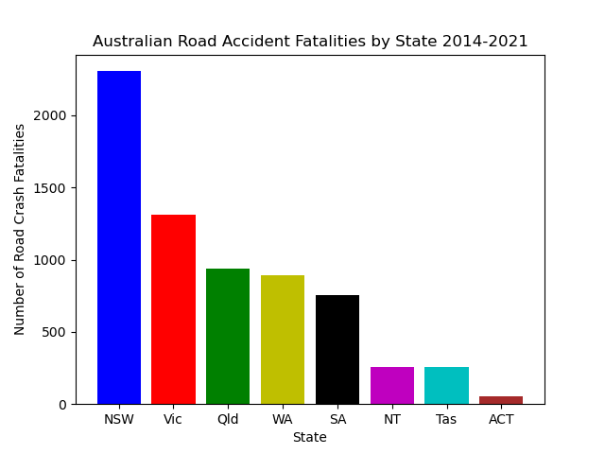
Figure 7: Bar chart representing the total number of fatalities from Australian Road Crashes 2014-2021 per state.

Slide 9
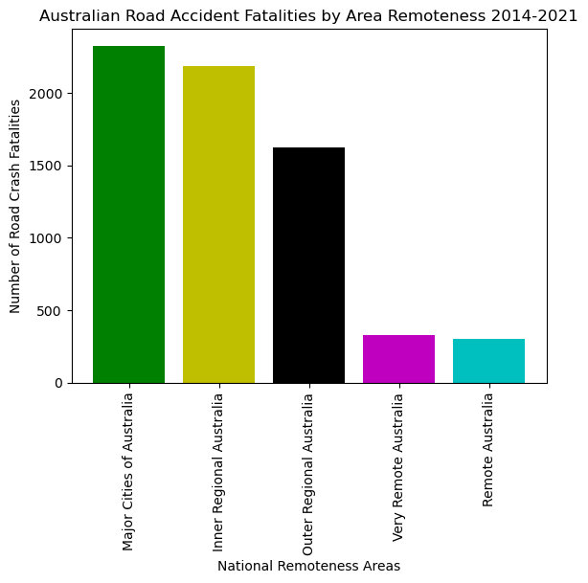
Figure 8: Bar chart representing the total number of fatalities from Australian Road Crashes 2014-2021 per area remoteness.

Slide 10
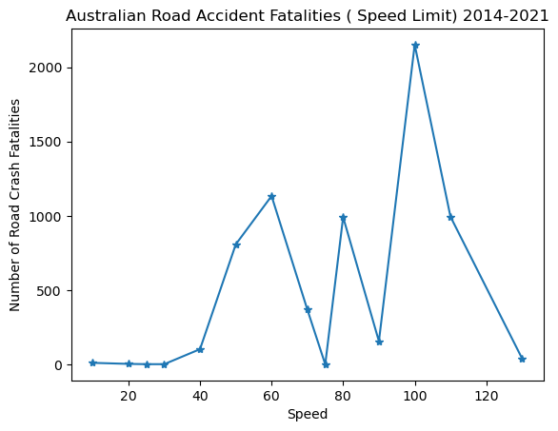
Figure 9: Line graph representing the number of fatalities from Australian Road Crashes 2014-2021 Per speed zone limit (km/h).

Slide 11
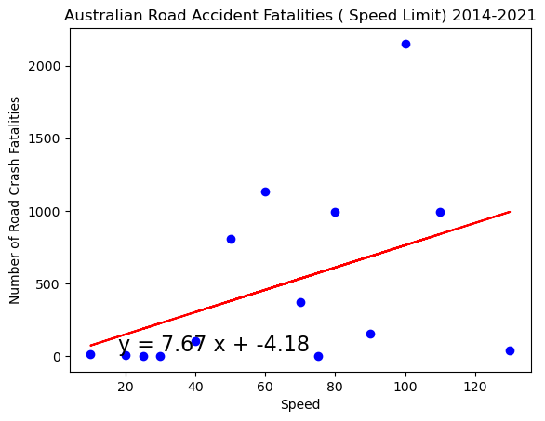
The mean speed limit of the crash site was 83km/h.
The median speed limit of the crash site was 80km/h.
The correlation co-efficient between the speed limit of the crash site and the number of fatalities from Australian road accidents was 0.18 showing there a very weak positive relationship.
Figure 10: Scatter plot representing the number of fatalities from Australian Road Accidents 2014-2021 vs the speed limit of the crash site (km/h).

Slide 12
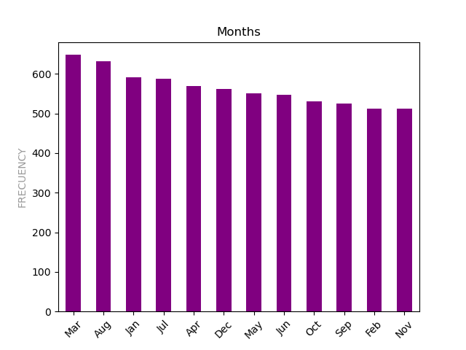
Figure 11: Bar chart representing the total number of fatalities from Australian Road Crashes 2014-2021 per calendar month.

Slide 13
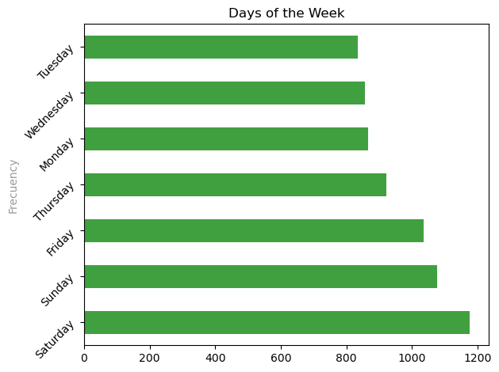
Figure 12: Bar chart representing the total number of fatalities from Australian Road Crashes 2014-2021 per day of the week.

Slide 14
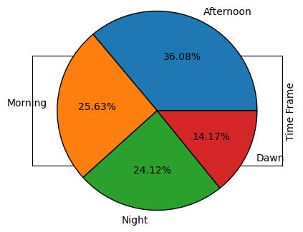
Figure 13: Pie chart representing the percentage of total fatalities in Australian Road Crashes 2014-2021 each 6-hour period of the day represents.

Slide 15
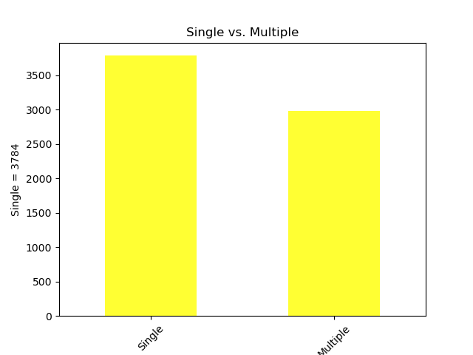
Figure 13: Bar chart representing the total number of fatalities from Australian Road Crashes 2014-2021 occurring from single and multiple vehicle accidents.

Slide 16
Conclusion
Based on the findings:
The target audience is male drivers aged between 18 and 30
The campaign should focus on NSW as they have the highest number of crashes, followed by Victoria
There are no “danger days” or “danger months” to focus on so ads should be played all year
Most crashes occur during daylight at high speeds of 80-100 km/h so these conditions should be featured in the ad
The setting of the ad should be inner city or regional areas as this was where most fatal crashes occurred.

